Slide 1

⚙️ Syntax and Arguments
The forEach() method takes a callback function as its argument. This callback function can accept up to three arguments in this exact order:
Element (required): The current item being processed.
Index (optional): The index number of the current item.
Array (optional): The entire array forEach() was called upon
Welcome

Slide 2
01. Understanding forEach()
The forEach() method is used to loop through arrays and execute a specific function once for each array element. It is a cleaner, more modern alternative to traditional for loops when you need to run code for every item in a list. once for every element in an array.
⚙️ Syntax and Arguments
The foreach() method takes a callback function as its argument. This callback function can accept up to three arguments in this exact order:
Element (required): The current item being processed.
Index (optional): The index number of the current item.
Array (optional): The entire array foreach() was called upon
let numbers = [10, 20, 30];
numbers.forEach((a, b, c) => {
console.log(a);
console.log(b);
console.log(c);
});

Slide 3
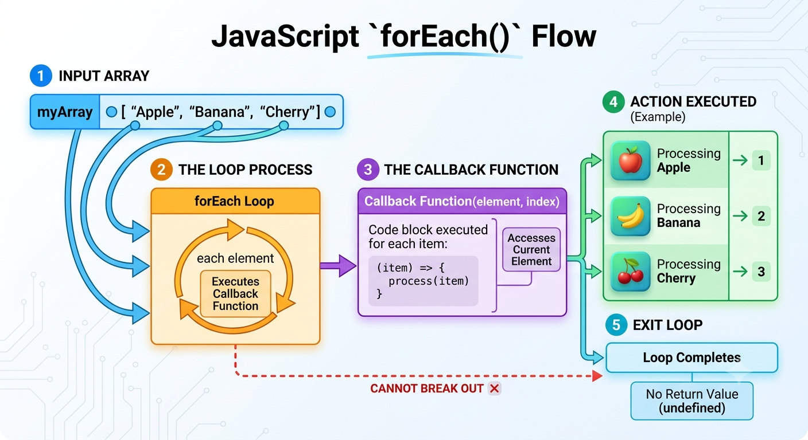
forEach()

Slide 4
02. Understanding concat()
The concat() method is used to merge two or more arrays or strings together. This method does not change the existing arrays or strings; instead, it returns a new array or string
⚙️ Syntax and Arguments
The syntax of the concat() method is array1.concat(array2, array3, ...). Here, array1 represents the original array on which the concat() method is called. The concat() is the method used to combine the elements, while array2, array3, and other arguments represent the arrays or values that need to be added to the original array. The method combines all the given elements in the same order and returns a new array containing the combined elements.
Example:
array1.concat(array2, array3);
const arr1 = ['a', 'b’];
const arr2 = ['c', 'd’];
const merged = arr1.concat(arr2);
// merged is ['a', 'b', 'c', 'd']

Slide 5
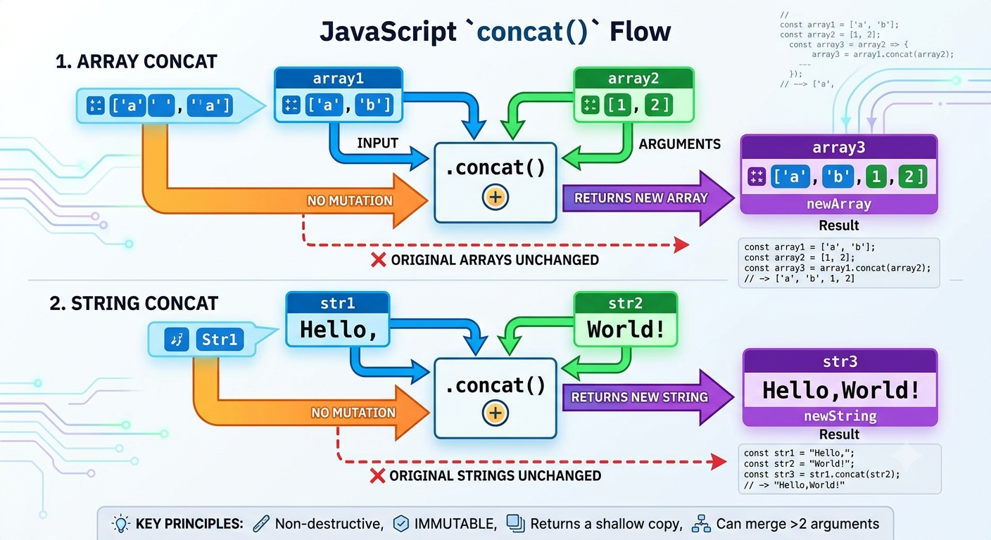
concat()

Slide 6
03. Understanding join()
The join() method creates and returns a new string by concatenating all of the elements in an array. By default, the elements are separated by commas. However, you can provide an optional separator argument to specify exactly what character(s) should sit between the items. If an element is undefined or null, it is converted to an empty string.
⚙️ Syntax and Arguments
Array.join(separator) Here, array represents the original array whose elements need to be combined. The join() is the method used to combine all the elements of the array into a single string. The separator is an optional argument that specifies what should be placed between each element in the resulting string. If no separator is provided, JavaScript uses a comma (,) by default. The join() method does not modify the original array; instead, it returns a new string containing all the elements joined together.
let fruits = ["Apple", "Mango", "Orange"];
let result = fruits.join(" - ");
console.log(result);
// Apple - Mango - Orange

Slide 7
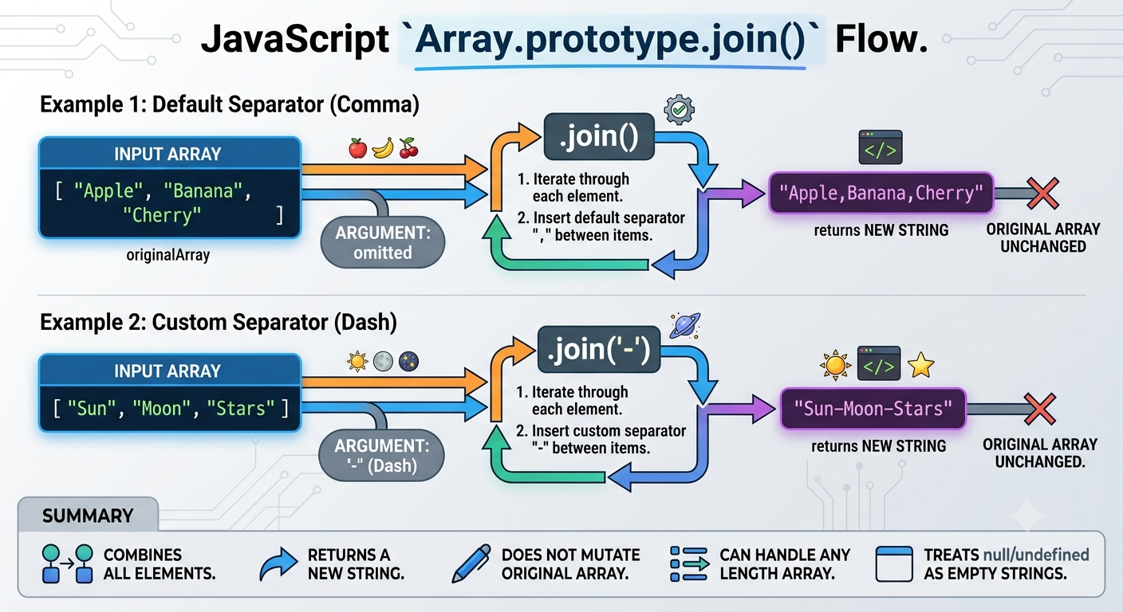
join()

